Slide 1

BREAST CANCER DIAGNOSIS USING MACHINE LEARNING
BINARY CLASSIFICATION TO DETECT MALIGNANT VS. BENIGN TUMORS
DATASET: WISCONSIN DIAGNOSTIC BREAST CANCER (WDBC)

Slide 2

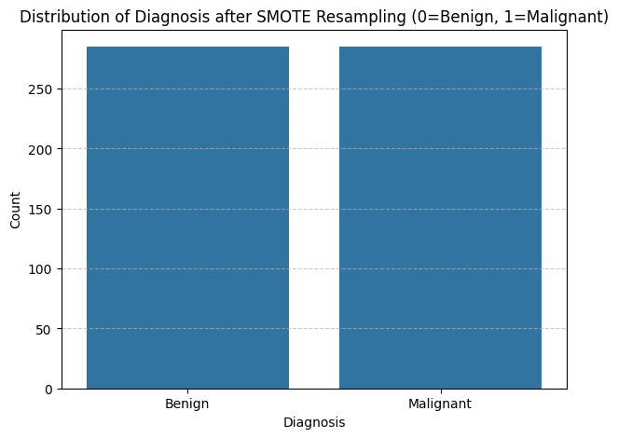
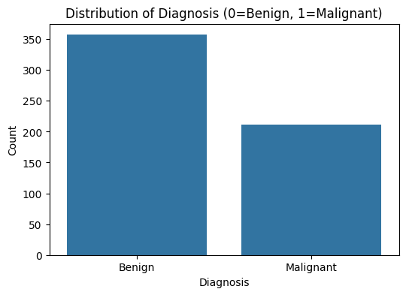

DATA OVERVIEW
569 samples, 30 features
Addressed via SMOTE
Class Imbalance

Slide 3
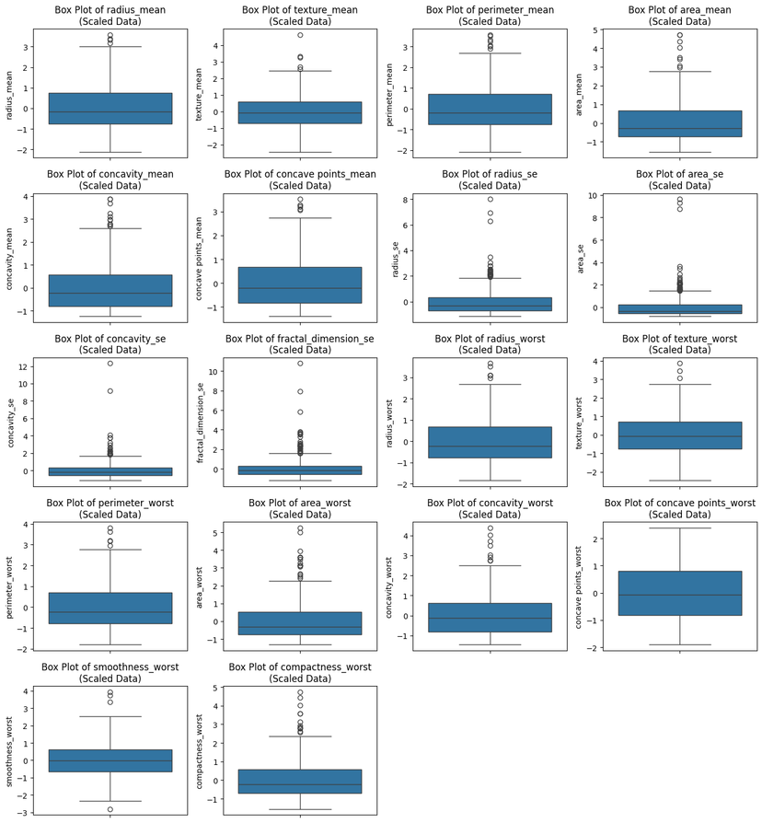
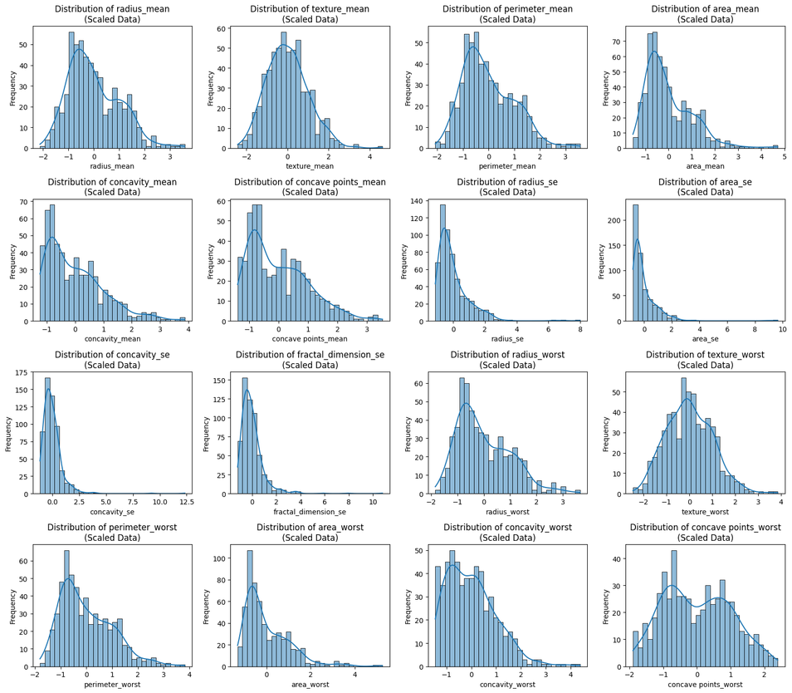
FEATURE DISTRIBUTION & OUTLIERS
Many features are skewed with visible outliers, motivating scaling/transformation

Slide 4
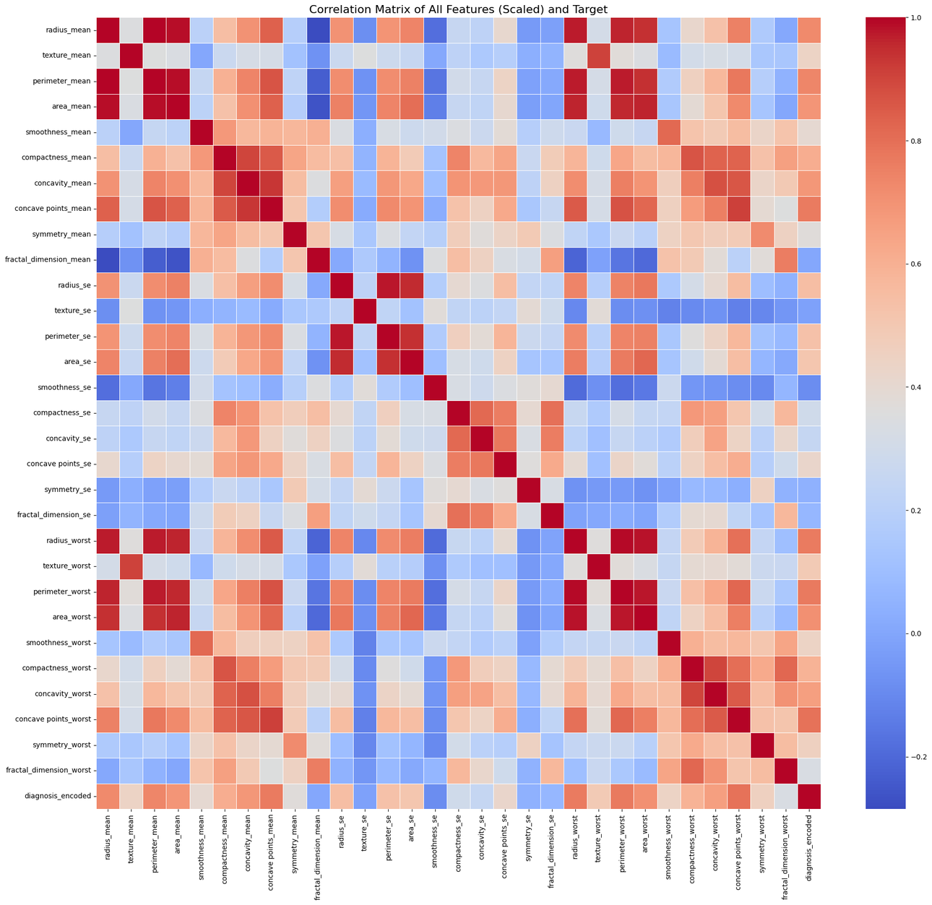
FEATURE CORRELATION
Diagnosis is highly correlated with certain “worst” and “mean” features

Slide 5
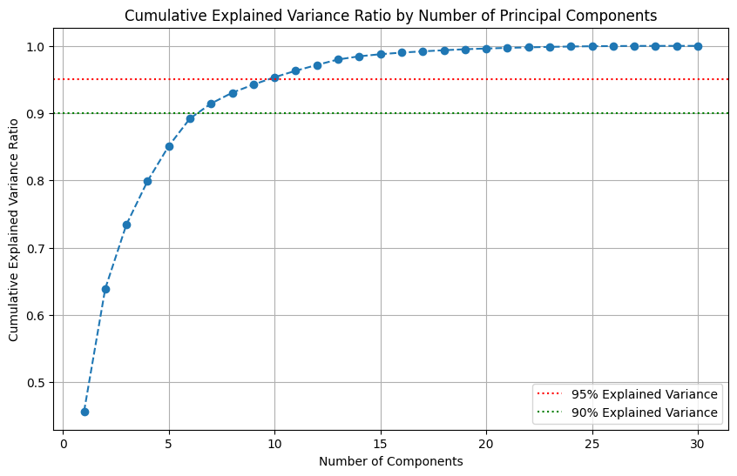
DIMENSIONALITY REDUCTION
PCA can simplify modeling and resolve multicollinearity if further optimization needed

Slide 6
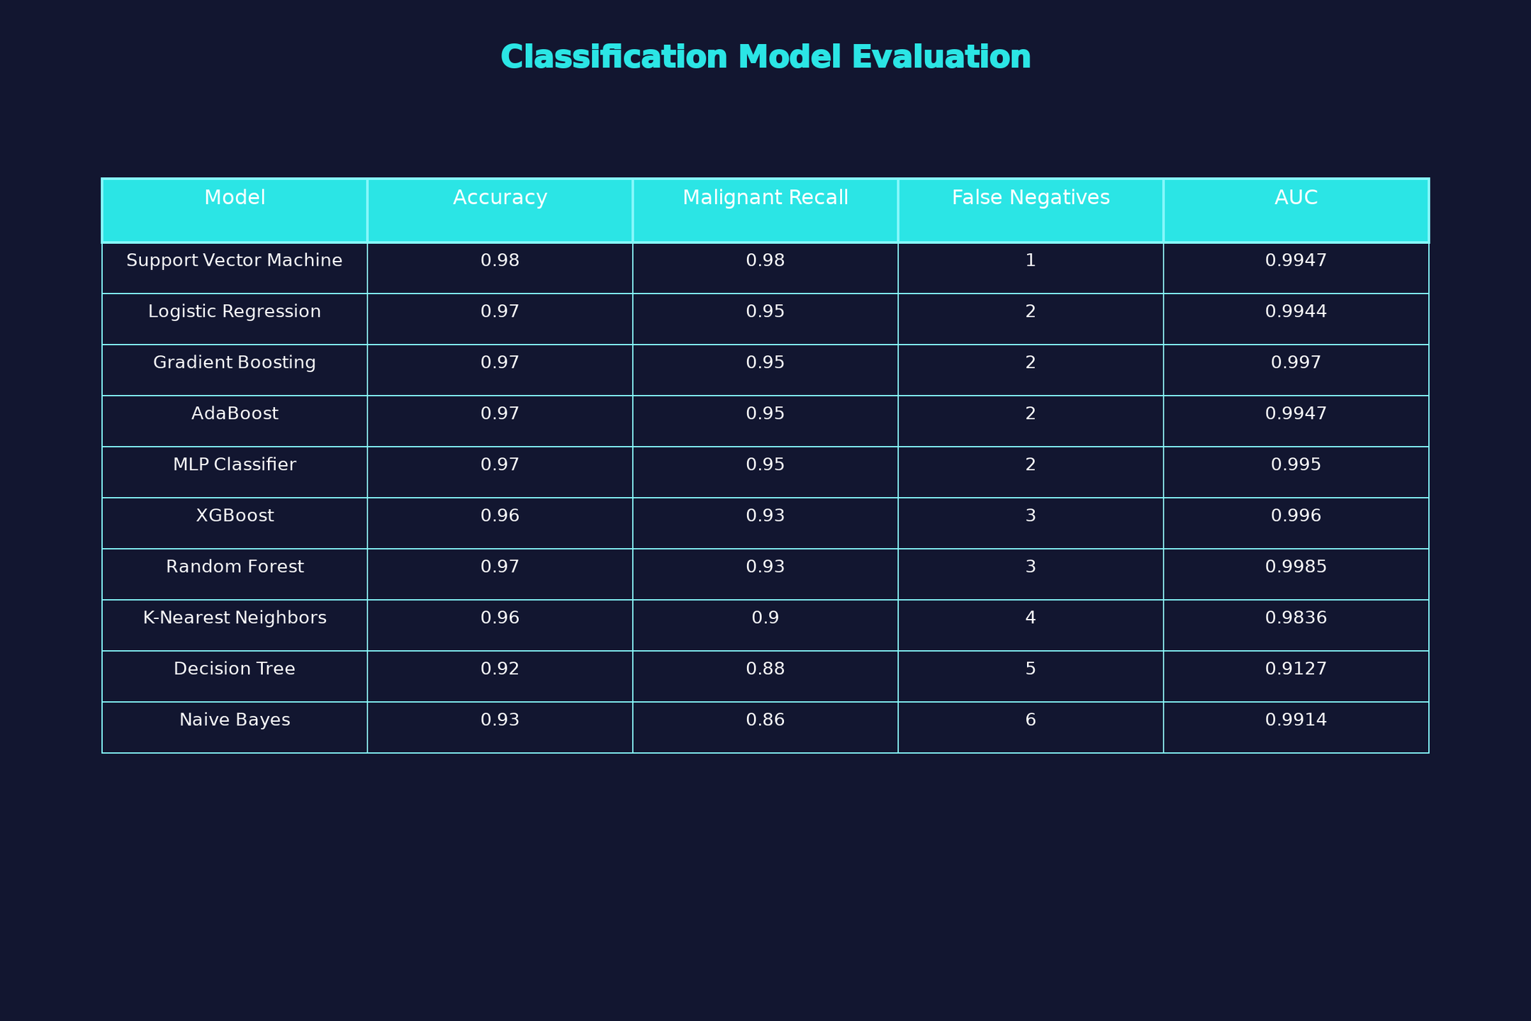
CLASSIFICATION MODEL EVALUATION

Slide 7
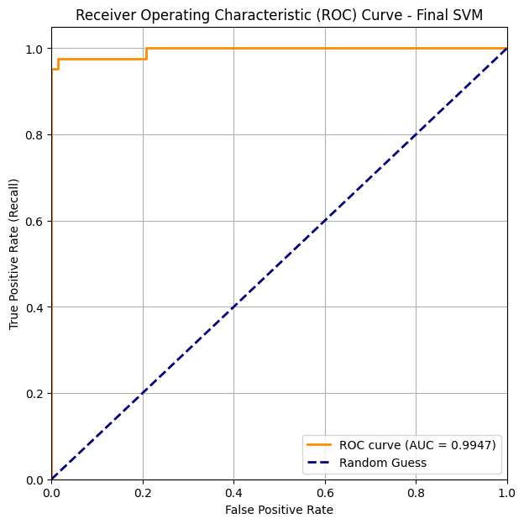
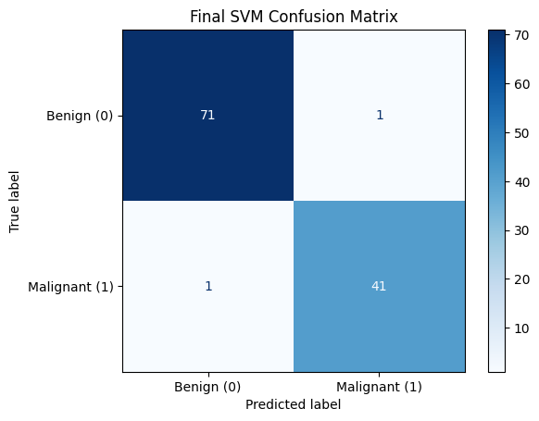
MODEL EVALUATION - SVM (BEST MODEL)

Slide 8
CONCLUSION & RECOMMENDATIONS
DEPLOY MODEL AS PART OF A CLINICAL TOOL; CONSIDER FURTHER FEATURE REDUCTION AND ENSEMBLE MODELS FOR FUTURE WORK
SVM ACHIEVES HIGH RECALL/ACCURACY CRUCIAL FOR MEDICAL APPLICATION
OUTLIERS, FEATURE SKEWNESS, AND CLASS IMBALANCE STRONGLY IMPACT MODELING

Slide 9
THANK YOU
NAME: SUJAL JUNGHARE
7TH SEMESTER ‘C’
PRN: 22070521089

